Slide 1


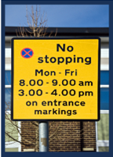








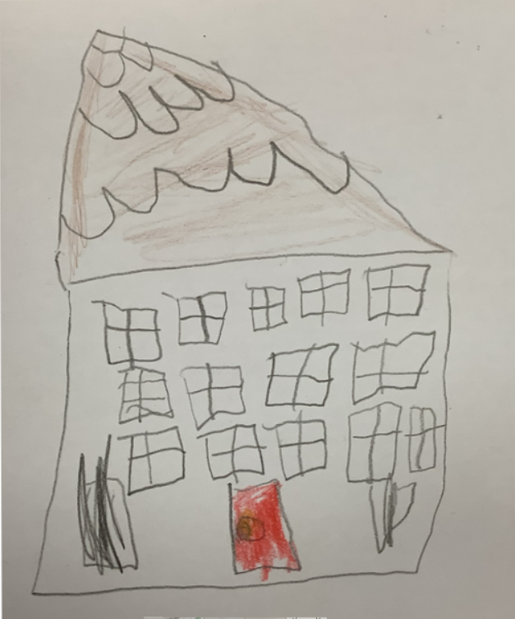


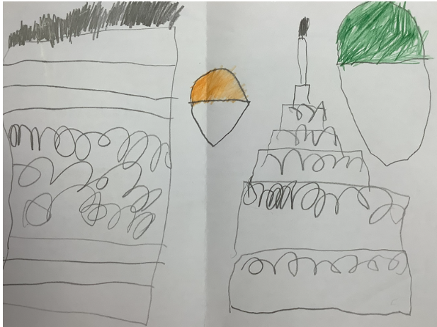

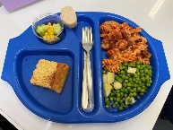


Hill View Primary Academy
Parking
Following on from the Walk to School Challenge, to help keep the road outside our school safe and with cleaner air to breathe, we ask that our families walk, cycle or wheel to school wherever possible.
Only drive to school if you really need to.
Park at least 5 minutes from school if you need to drive, and stride/scoot/cycle the rest of the journey.
Follow the Highway Code and park responsibly and legally away from zigzags, double yellow lines and junctions.
Respect our local neighbours and park considerately, keeping residents’ driveways and all pavements and dropped kerbs clear.
Drive slowly and attentively, particularly when close to school.
If driving, turn off your engine when stopped, to help keep the air around the school safe and healthy for all to breathe.
Reach For The Stars
Newsletter No.3
w/c 21st September 2026
=================================
Week Commencing
28th September 2026
Wednesday 23 September – Thursday 1 October 2026 – Life Tent
Friday 2nd October –
Armatrading Class Swimming
EYFS Update
Donaldson and Rosen Reception classes have settled into school life wonderfully and have made a fantastic start to their reception journey. The children have enjoyed exploring the school and the EYFS area, becoming increasingly confident in their new environment. They have quickly learned the class routines and are amazing at following them, showing great independence and enthusiasm each day. As part of our "All About Me" topic, the children have loved sharing special information about themselves, including their favourite foods, favourite colours and things they enjoy doing. This week, we have started phonics and have been blown away by how well the children are listening, joining in and understanding new learning. They have also enjoyed putting on puppet shows, making hats, practising name writing and learning in the quad. We are incredibly proud of how well they have settled and all that they have achieved already.
Pupil Absence
If your child is going to be absent from school, please inform the school office:
Tel: 01202 514109
E-mail: reception@hillviewacademy.org
Office open hours:
8.00am – 4pm. Mon – Fri. Term-time only
If leaving a message or sending an e-mail, please give the child’s name & class. We are required to record the reason for any absence. Please let us know your child’s specific symptoms e.g. temperature, cold/flu symptoms, vomiting etc.
The NHS website has advice regarding keeping your child away from school if they are unwell
Contact Us
Office: reception@hillviewacademy.org
SENCo/ Miss Ellis: senco@hillviewacademy.org
Morning club: morningclub@hillviewacademy.org
After School Club: afterschoolclub@hillviewacademy.org
Website: www.hillviewacademy.org
Parking
Please bear in mind the road parking zones
around the school, as we all want to keep
the roads in the area of the school safe for
our families and residents
Follow the Highway Code and park responsibly and legally away from zigzags, double yellow lines and junctions.
Please remember that the disabled parking bays outside the school should only be used by if you have a valid blue badge.
Please respect our local neighbours and park considerately, keeping residents’ driveways and all pavements and dropped kerbs clear.
Drive slowly and attentively, particularly when close to school.
If driving, turn off your engine when stopped, to help keep the air around the school safe and healthy for all to breathe.
Illegally parked vehicles can be reported to parking@bcpcouncil.gov.uk
Just a reminder that the area by the year 3 gate is a NO PARKING or WAITING at anytime, this area is in use for collection/access for after school clubs and if there was an emergency.
Thank you for your support and consideration of others
Hot School Meals (Forerunner)
Deadline: midnight on Mondays for the following week
HOT SCHOOL MEALS
The cost of a hot school meal is £2.80 for pupils in KS2, pupils in KS1 and EYFS are entitles to universal infant school meals

Slide 2














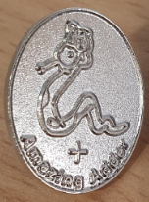



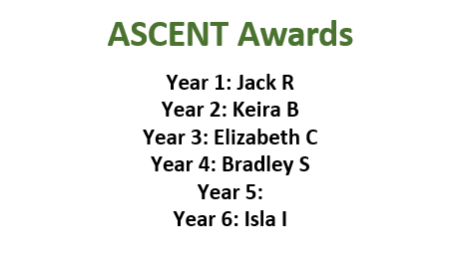

Kezia B
Online Safety
At school, we take online safety very seriously and work hard to provide children with a safe, monitored and supportive digital environment. However, it is important to remember that the internet can never be 100% safe, and occasionally things may go wrong despite everyone's best efforts.
When challenges arise, we see these as valuable learning opportunities. We support pupils to understand what happened, make safe choices and develop the skills they need to navigate the online world confidently and responsibly. Our aim is not only to protect children, but also to empower them to recognise risks, seek help when needed and become resilient digital citizens.
We encourage parents and carers to continue conversations about online safety at home. By working together, we can help children enjoy the benefits of technology while staying as safe as possible online. 💻📱🌐
This week’s Wizards
–
Year 1 – Ronnie L
Year 1 – Franke W
Year 1 – Erin M-S
Year 2 – Faith
Year 2 –Alice G
Year 2 – Teo
Year 3 – Poppy C
Year 3 – Nicole K
Year 3 – Henry F
Year 4 – Nathan G
Year 4 – Robyn
Year 5 – Florence B-P
Year 5 – Kara L
Year 5 – Evie C
Year 6 – Marco R
Year 6 – Emilia H
Year 6 – Gabriella
-----------------
Children should also only have water in their water bottles. Please remember that we are a nut-free school.
Thank you for your cooperation.
.
INSPIRING INDIVIDUAL TROPHY
Attendance Cup Winners
w/c 21st September 2026
YR – Rosen Class 97.7%
KS1- Van Gogh Class 99%
Lower KS2 – Johnson Class 97.6%
Upper KS2 – Pankhurst Class 99%
Smile Badge
Year 2 - Daisy S
.
Staying safe in hot weather requires a mix
Staying hydrated,
Apply sun cream
Wear a sun hat
Loose clothing
Avoid being out in the sun between 11:0 to 15:00
You will only need to attend one.
Children will meet their new teacher on Monday 20th July 2026
More information will follow nearer the time.

Slide 3



Year 6 transfer to Secondary School
Further to the letter sent to you at the beginning of the month, this is just a reminder that you need to apply for your child’s secondary school through the BCP Portal by Saturday 31st October 2026
https://bcp.cloud.servelec-synergy.com/Synergy/ApplyforaSchoolPlace.aspx
Parental Guide
https://www.bcpcouncil.gov.uk/schools-and-learning/school-admissions/parents-guide-to-school-admissions
If you have any queries please contact the Children’s information Service on 01202123222 or email cis@bcpcouncil.gov.uk
Thank you
--------------------------
School Office Hours
The office open hours are 8:00am – 4:00pm. If you call outside of our open hours, please press “0” when prompted to leave a voice message. Alternatively, you can send us an e-mail at reception@hillviewacademy.org
Please note that the office is not open during school holidays, and that INSET days are used for training, planning and preparation. Please bear with us when we re-open after school holidays while we endeavour to respond to e-mails and messages sent while we have been closed.
Thank you.
Year 6 Residential
Year 6 residential is Monday 28 June – Thursday 1st July 2027
Reminder that the £50 deposit and reply slip is due by end of day Friday 2nd October 2026.
Thank you
Year 4
Payment £14 for the year 4, Tree House Theatre and Pizza Express trips is due by Wednesday 7th October 2026.
I
Looking After Our Mental Health
Just as we look after our physical health, it is important that we take care of our mental health too. Throughout school, we encourage children to talk about their feelings, build positive friendships and develop strategies to help them manage worries and challenges.
We remind children that it is always okay to ask for help and that there are trusted adults in school who are ready to listen and support them. By working together, we can help every child feel safe, valued and confident.
If you have any concerns about your child's emotional wellbeing, please do not hesitate to speak to a member of staff. Together, we can ensure all children thrive both in and out of the classroom.
Autumn Term Dates for your diary
Life Bus:
Wednesday 23rd September – Thursday 1st October 2026
Monday 19th October –
Harvest - Donations to the Food Bank
Thursday 22nd October
Year 4 – Tree House Theatre – Roman Day
October Half term:
Monday 26th October to Friday 30th October 2026
School Photos:
Individual and sibling school photos will take place on Monday 2nd and Tuesday 3rd November 2026
-------------------

Slide 4













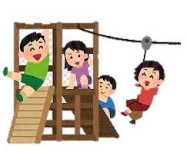
PTFA News
PTFA Next meeting:
Our next meeting will be on 7th October at 7.30pm at Hill View School in the South Hall. Please come along if you would like to know what we are doing, get involved or bring ideas!
PTFA Volunteer Events Team
Formerly known as PTFA lite, this is our wonderful army of volunteers who help make events happen.
Would you like to be involved in events but only when you are able?
EMAIL: hillview.ptfa@hotmail.com use the word volunteer and we will get you signed up.
We value our volunteers as part of the PTFA and only want you to help as much as you are comfortable.
Upcoming Events:
BOO-Bingo - Friday 13th of November at Hill View School
Back by popular demand! Matt our Bingo caller is brushing up on his calls ready for another night of fun.
Look out for ticket sales in the next couple of weeks.
See if you can get us to a full house!
Fundraising Targets:
The PTFA are currently fundraising to continue to upgrade the ever popular Adventure Playground equipment.
Due to the high standards of school playgrounds and our wish to put in something that can be used well in to the future, this is a big undertaking for the PTFA but with your help we can get there!
PTFA Team Spotlight:
Uniform Preloved & NEW!
We have a wide range of stock available of new Uniform to purchase from us. Please see our updated price list below or by clicking here to
view on the school website.
We continue to have stock in the main office
for pre-loved items. An honesty box is at the reception desk. We only accept cash for pre-loved.
I
If you have any clean, good quality items for donating, please leave in a bag under the existing clothes rail. All donations are gratefully received.
Thank you.
---------------
Classlist
If you haven’t already done so, please sign up to Class List. This app helps keep track of events and enables you to book tickets and pay for PTFA events.
-----------------------------------------------------
.
Recommended Read Year 6
-------------------
How to reach us:
Email: Hillview.ptfa@hotmail.co.uk
Facebook: www.facebook.com/hillview.primaryptfa/
Classlist: https://classlist.page.link/6d9FBeD11FcyAUrC7
Hill View Primary Academy P.T.F.A. Committee Member
Reg. Charity No. 800662

Slide 5





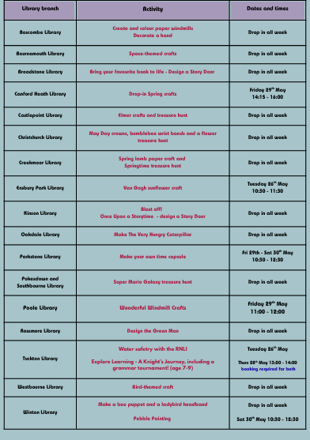






Yea5 Parents information
Reception Classes September 2027
If you have a child due to start school in September 2027, we would be delighted to welcome you for a tour of our school.
The tour dates and times are:
Friday 9th October at 11am
Thursday 15th October at 9am
Tuesday 20th October at 2pm
Friday 23rd October at 9.15am
If you would like to attend one of these dates, please contact the office on 01202 514109 or email reception@hillviewacademy.org
To apply for your child’s place please go to BCP Council admissions website.
School admissions | BCP
Key Admission Dates:-
Applications open: 1 November 2026
Closing date for applications: 15 January 2027
School offer day: 16 April 2027
Deadline for parents to accept their offer: 30 April 2027
Please see the link below for BCP Council Primary School Admissions Guide and further information about the application process.
Thank you
ADVERTS – Hill View Primary places all adverts in good faith. It should be noted however that the quality of products or services being offered have not been checked by the school nor are the school aware whether necessary DBS checks have been carried out. Hill View Primary is neither encouraging nor discouraging any advert placed.
Links to Letters & Home Learning
All copies of letters and home learning can be found on our school website under Parents – Letters.
Please click the links below to take you directly to these online pages:
Whole School Letters EYFS Letters
Year 1 Letters Year 2 Letters
Year 3 Letters Year 4 Letters
Year 5 Letters Year 6 Letters
The Green Cross Code Steps
Think first: Find a safe place to cross, then stop near the kerb.
Stop: Stand back a little way from the kerb where you can see traffic.
Look and listen: Look all around for traffic and listen.
Wait: If traffic is coming, let it pass and look/listen again.
Cross safely: When the road is clear, walk straight across—do not run
Reception Classes September 2027
If you have a child due to start school in September 2027, we have
Recommended Reads
Year 2
The Hedgehog – Dick King-Smith
Max is a hedgehog who lives with his family in a nice little home, but it's on the wrong side of the road from the Park where there's a beautiful lily pond and plenty of juicy slugs, worms and snails! The busy road is dangerous but Max is determined to make his way across. If humans can do it, why can't hedgehogs? His first attempt ends in a nasty bump on the head and, when Max tries to speak, he realises his words are all mixed up. He is no longer a hedgehog but a hodge-heg!
Little Bricks clubs have spaces, please see leaflet below for details. Thank you
Parents Guide to Starting Infant, First or Primary School 2027

Slide 6



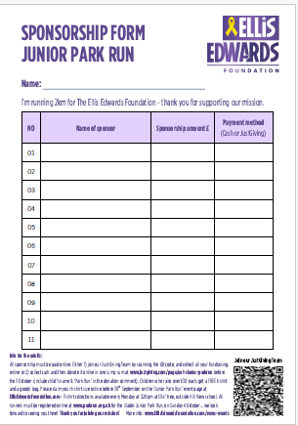
Ellis Edwards Foundation – Junior Park Run –
Sunday 4th October

Slide 7
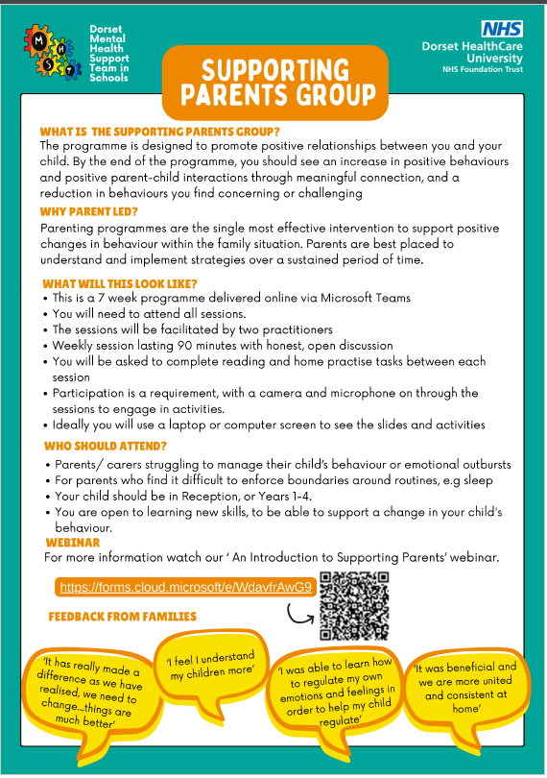
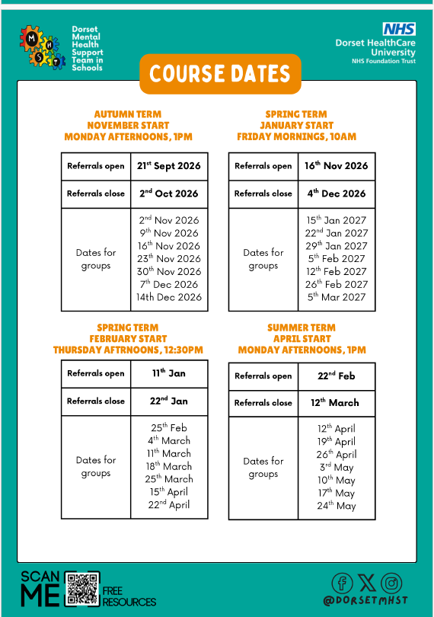
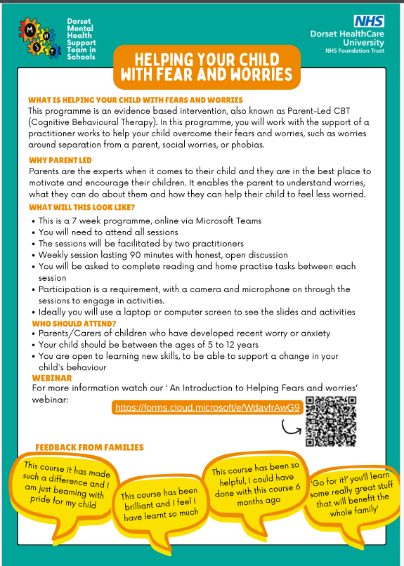
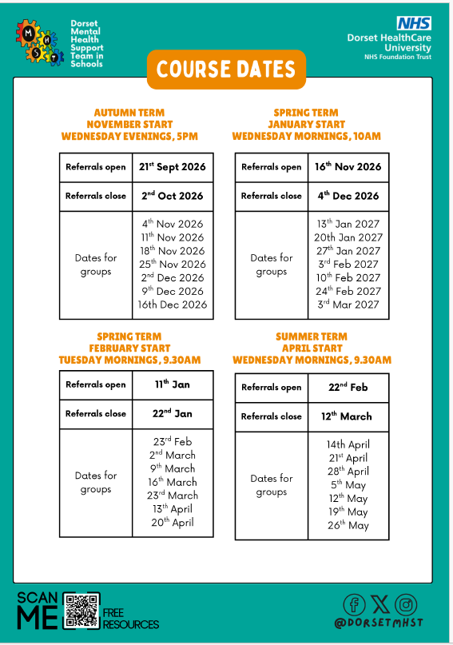
SUPPORT FOR PARENTS AND HOW TO SUPPORT YOUR CHILD WITH FEARS AND WORRIES

Slide 8




ADVERTS – Hill View Primary places all adverts in good faith. It should be noted however that the quality of products or services being offered have not been checked by the school nor are the school aware whether necessary DBS checks have been carried out. Hill View Primary is neither encouraging nor discouraging any advert placed.
Join Aspire Life We are running fun, daily clubs for primary kids at three local venues this October: St Katherine's, St James Primary, and Hengistbury Head Outdoor Centre. It’s a great way for children to stay active, learn new skills, and have fun outside of school hours. Find out more, check session times, and book a space here: aspirelifesports.magicbooking.co.u

Slide 9





Aspire Life are running fun, daily clubs for primary kids at three local venues this October: St Katherine's, St James Primary, and Hengistbury Head Outdoor Centre. It’s a great way for children to stay active, learn new skills, and have fun outside of school hours. Find out more, check session times, and book a space here: aspirelifesports.magicbooking.co.uk

